Slide 1
SRM MEDICAL STORE MANAGEMENT
BY:
Sai vivek A–AP23110010268
Sandeep m-AP23110010271
Tej Karthik N-AP23110010305
VENKAT SAI R-AP23110010334

Slide 2
Problem statement
Managing a medical store using traditional manual methods can be challenging, time-consuming, and prone to errors. Key problems include:
Stock Management Issues:
Difficulty in keeping track of medicine quantities, expiration dates, and reordering schedules.
Risk of stock shortages or overstocking, leading to financial losses or unmet customer needs.
Billing and Transaction Errors:
Manual billing is slow and error-prone, affecting customer satisfaction.
Inconsistent transaction records can cause accounting discrepancies.
Time-Consuming Processes:
Checking inventory and generating reports manually takes significant time and effort.
Redundant processes reduce operational efficiency.
Lack of Real-Time Data:
No immediate updates for stock levels, sales, or purchases, making it hard to make quick decisions.
Customer Management Challenges:
Difficulty in tracking customer purchase history or preferences.

Slide 3
Introduction
The SRM Medical Store Management System is a project designed to help medical stores operate more efficiently. Instead of relying on manual methods, this system uses software to make everyday tasks faster and easier.
Key Goals:
Manage Customers: Keep track of customer purchases and information.
Track Medicines: Monitor the stock of medicines, including their quantity and expiration dates.
Automate Billing: Quickly calculate total costs and print bills for customers.
Create Reports: Generate detailed reports on stock, sales, and purchases.

Slide 4
Methodology
Approach:
Data Modeling: Medicine attributes like ID, name, company, price, etc.
System Design: Modular structure using C++.
Workflow:
Input Handling
Data Processing
Output Generation
Tools: C++ programming, standard IDEs.

Slide 5
Medicine Class
#include <bits/stdc++.h>
using namespace std;
class Medicine
{
public:
int id, price, quantity;
char medicneName[100], Company[100], Mfg_Date[11], Exp_Date[11], info[5000];
};
class Medicine m[100];
void PurchaseMedicine(int number);
void EnterInfoAboutMedicine(int number);
void StockOfMedicine(int number);
void KnowInfoAboutMedicine(int number);
void AddMedicineinStore(int number, struct Medicine m[]);
void DeleteMedicineStore(int number);
void ChangeMedicineDetails(int number);

Slide 6
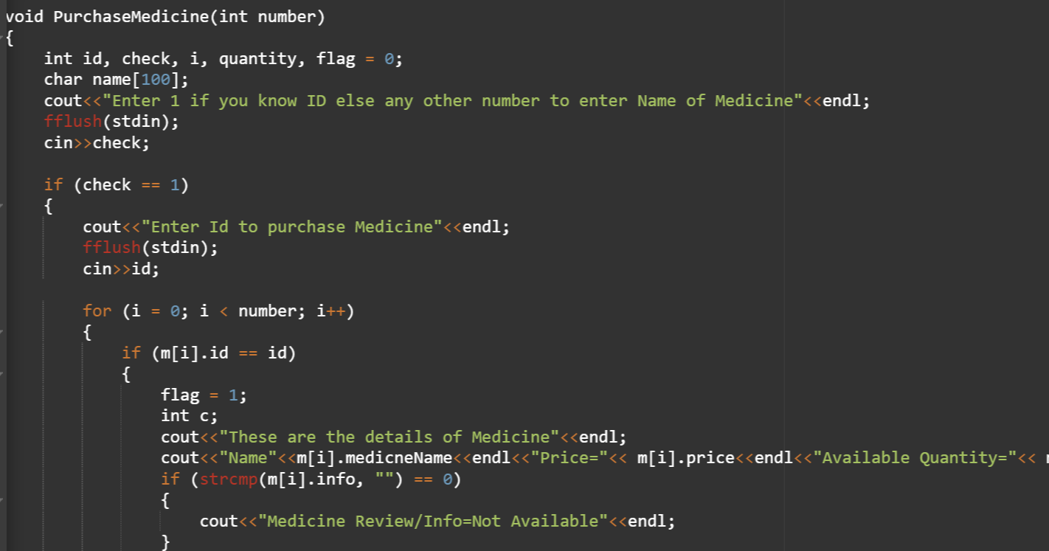
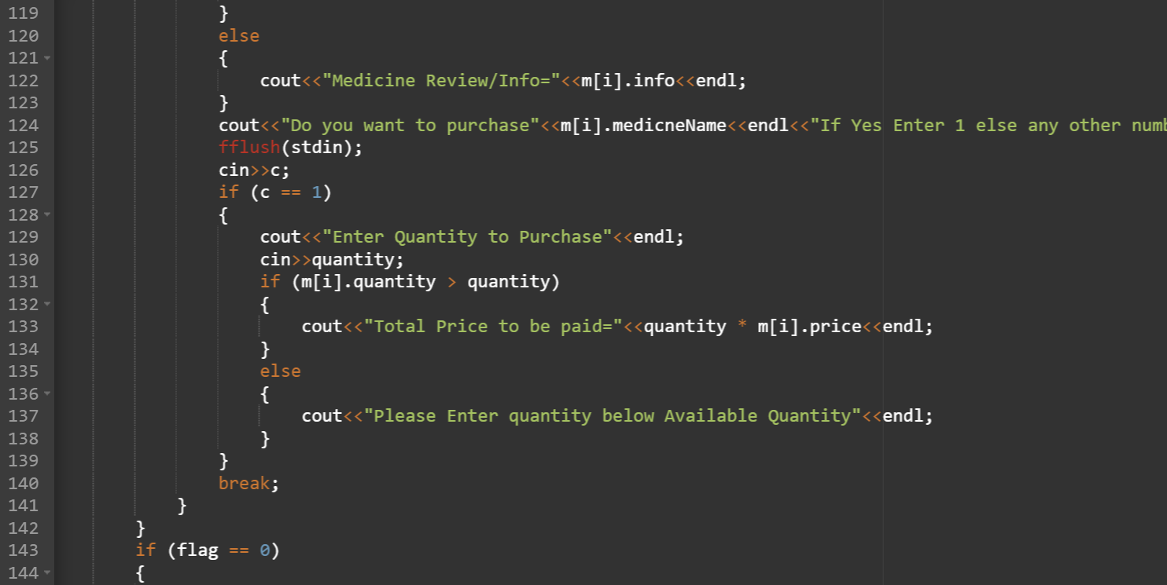
Purchasemedicine:

Slide 7
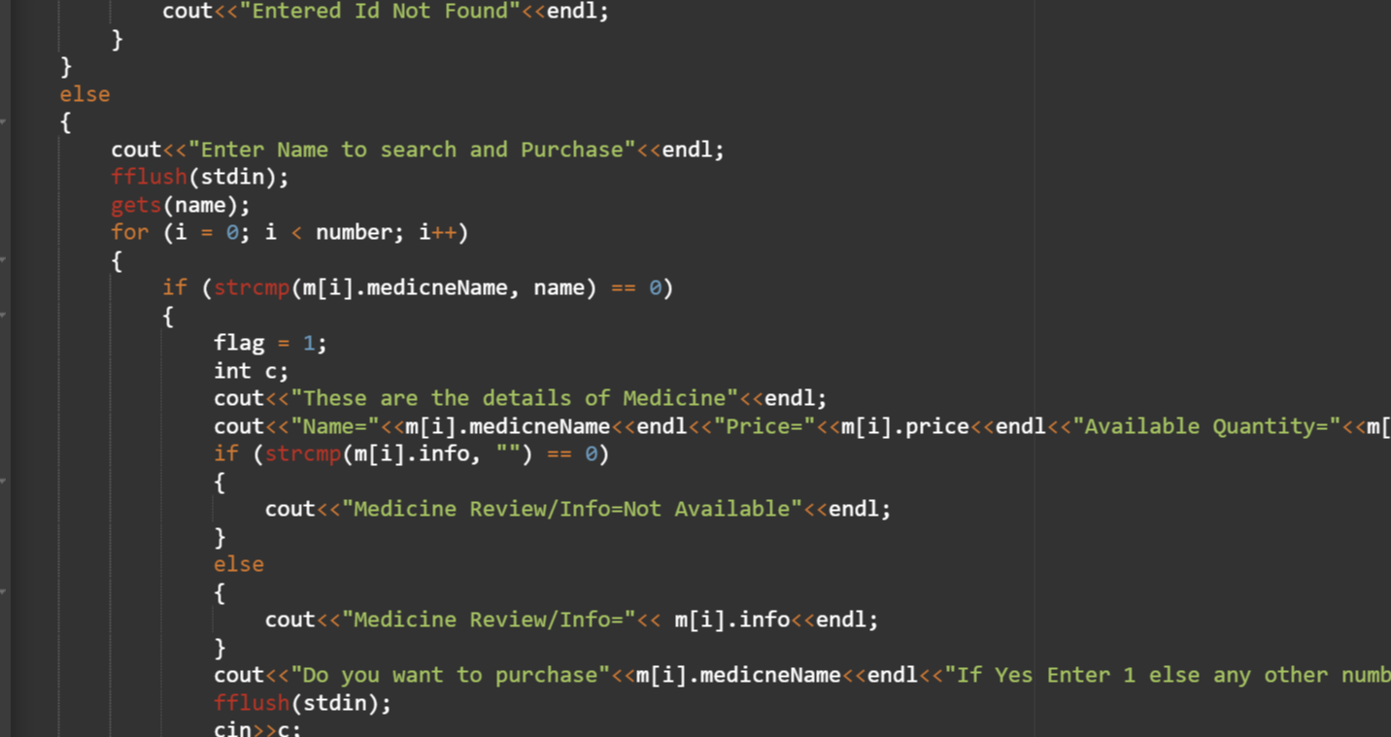
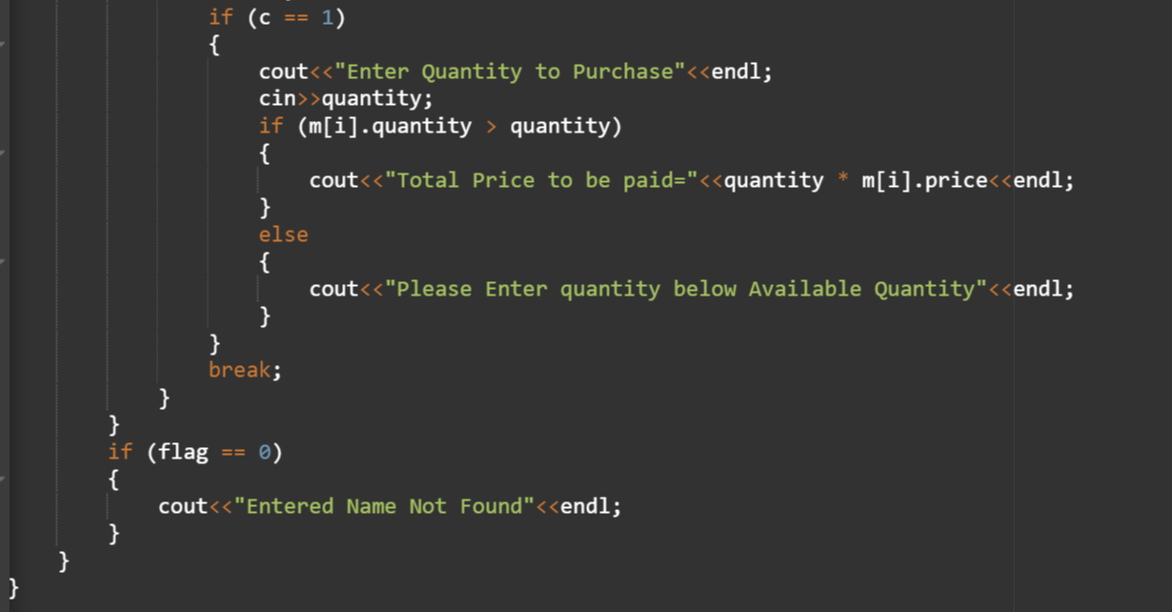
:

Slide 8
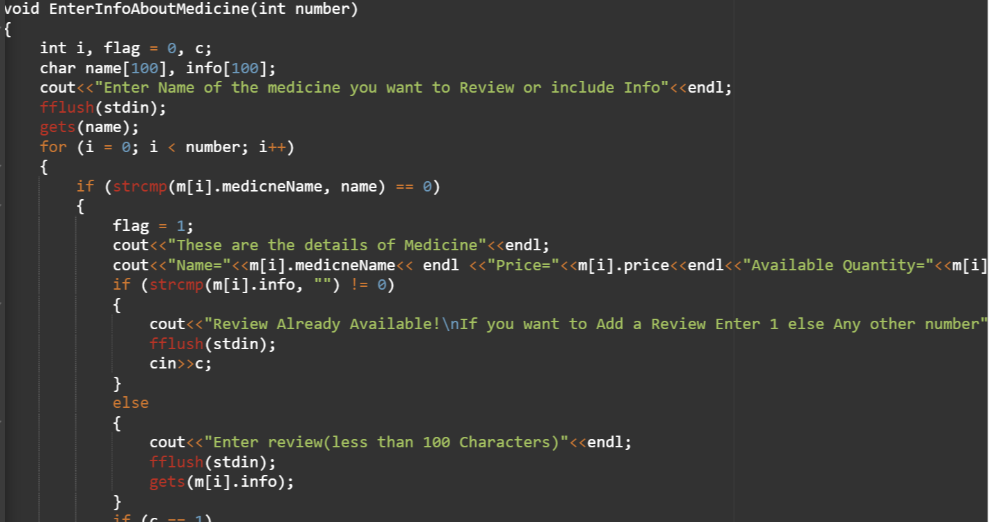
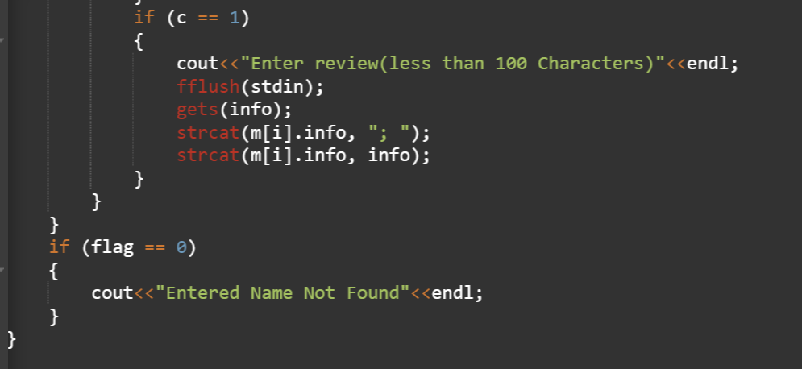
Enterinfoabout medicine :

Slide 9
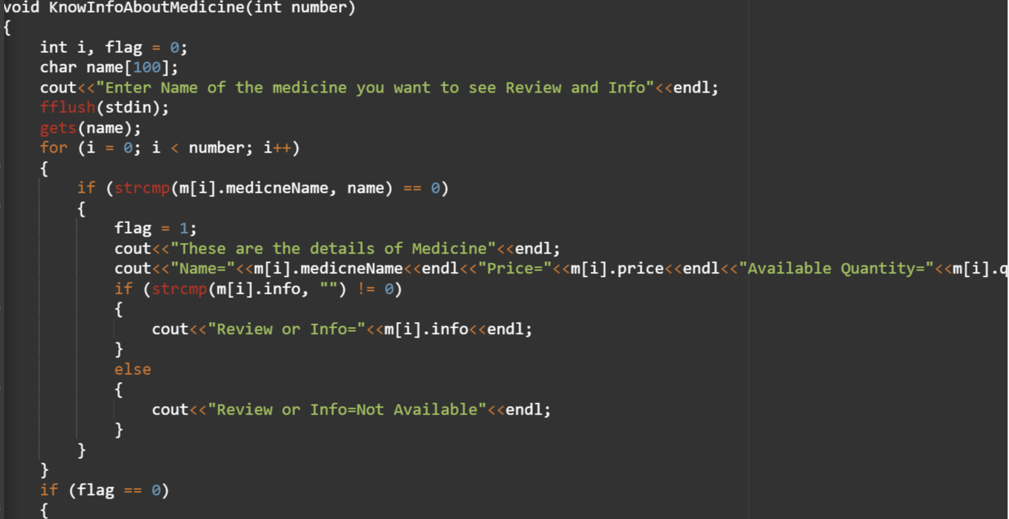
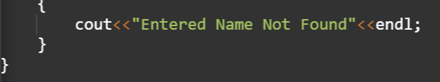
Knowinfoaboutmedicine :

Slide 10
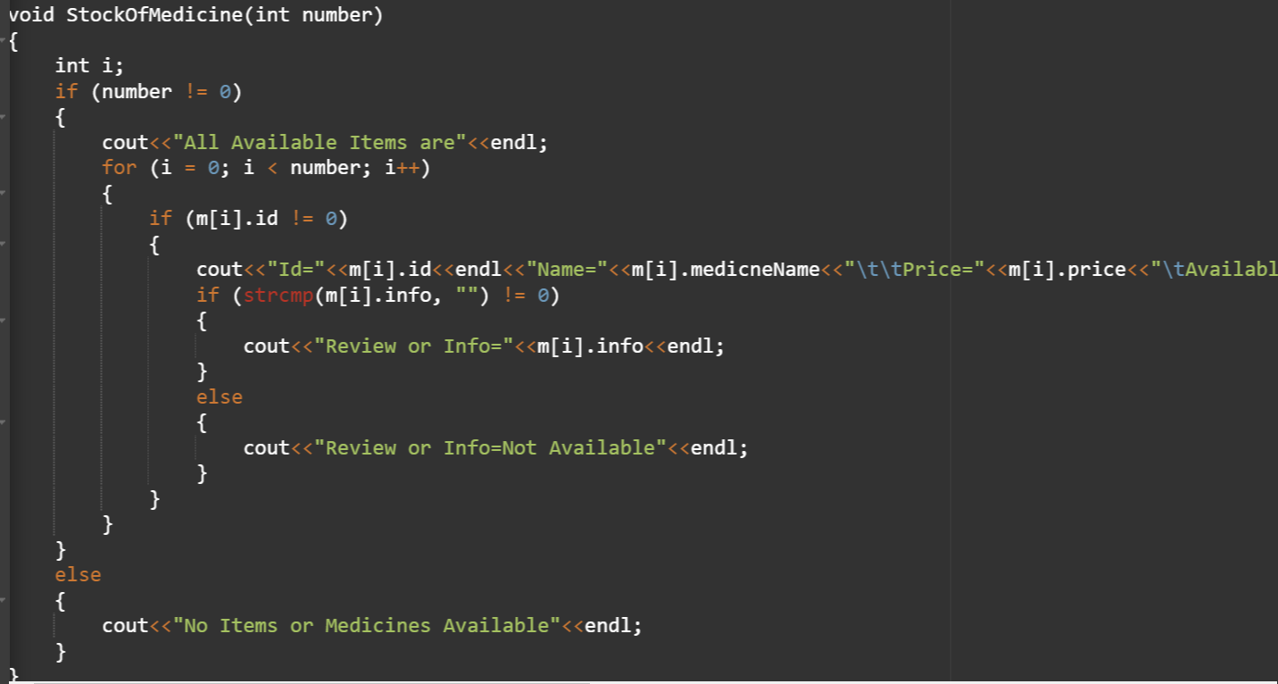
Stockofmedicine :

Slide 11
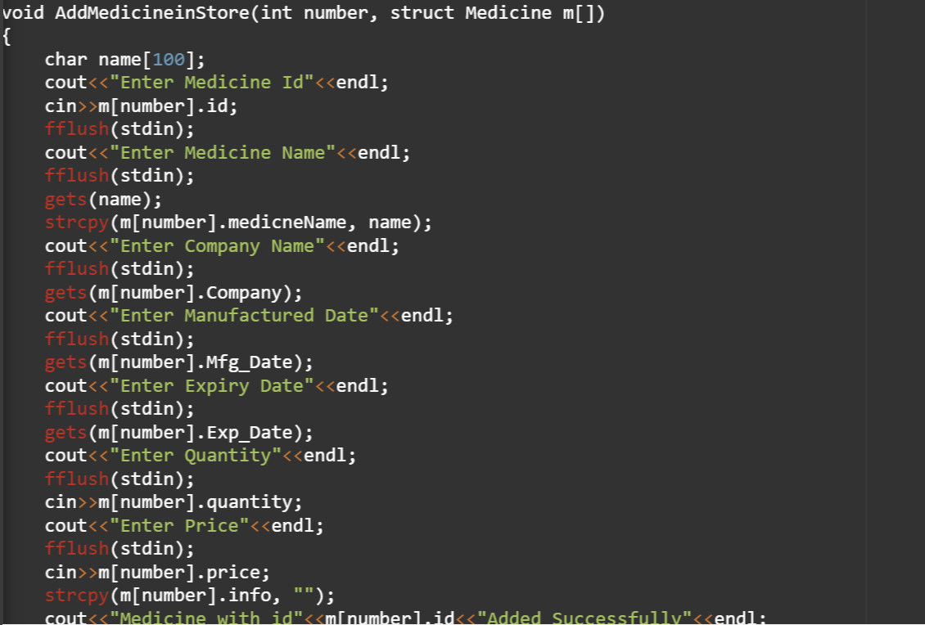
Addmedicineinstore :

Slide 12
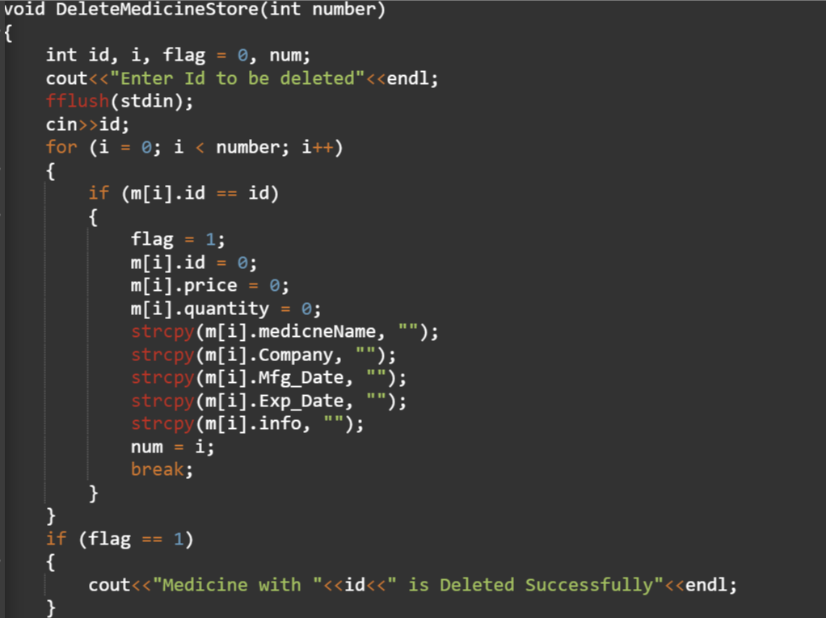
Deletemedicinestore:

Slide 13
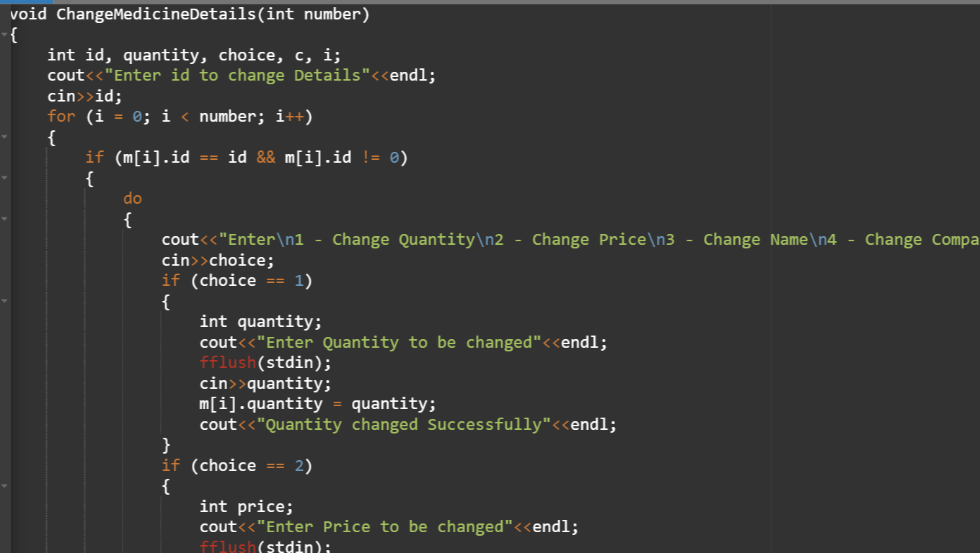
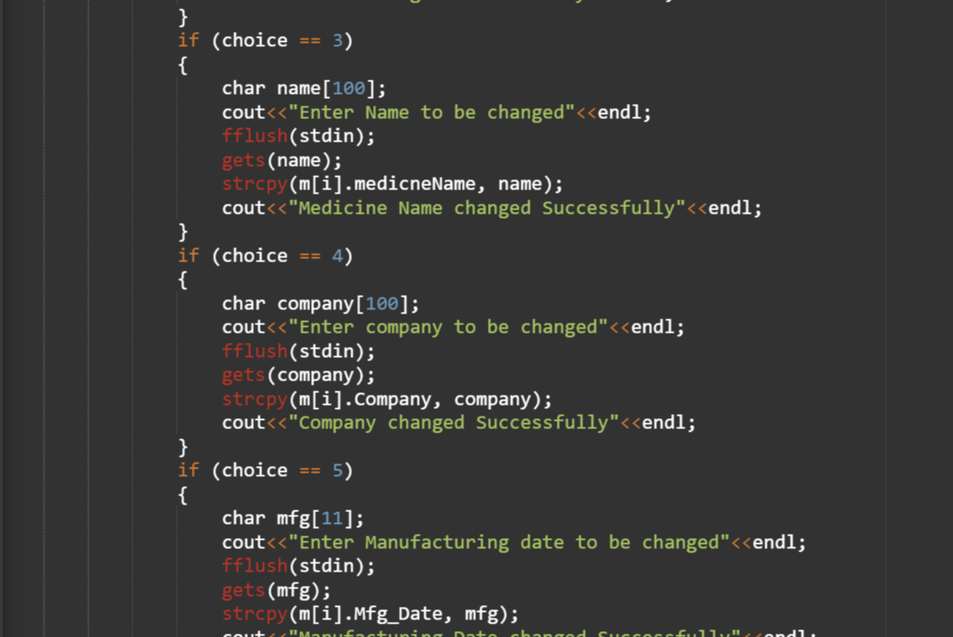
Change medicinedetails:

Slide 14
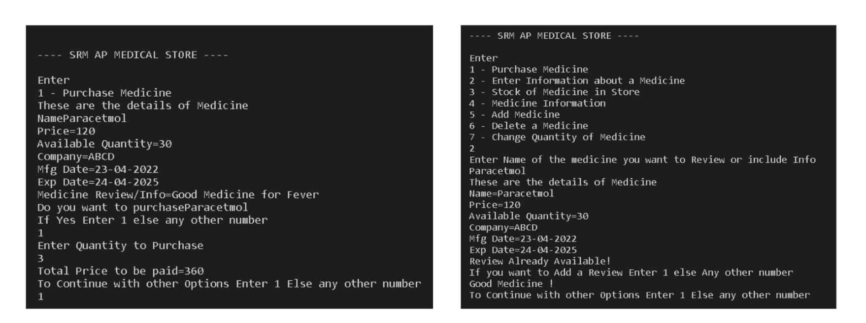
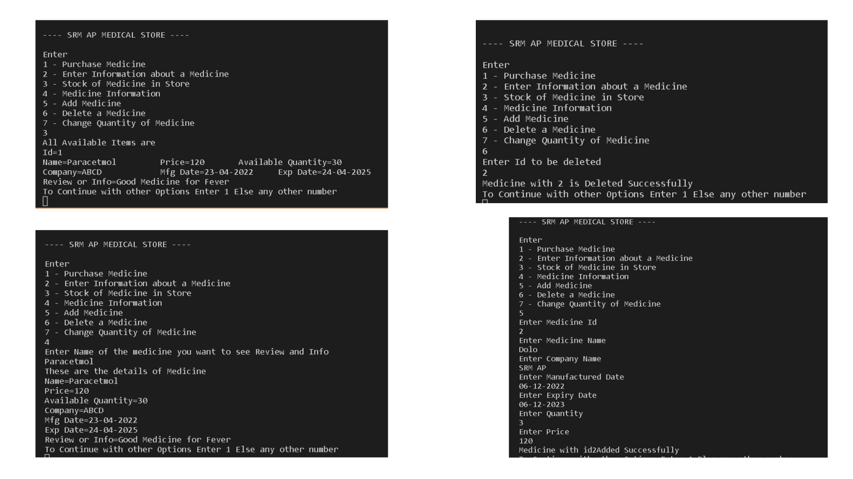
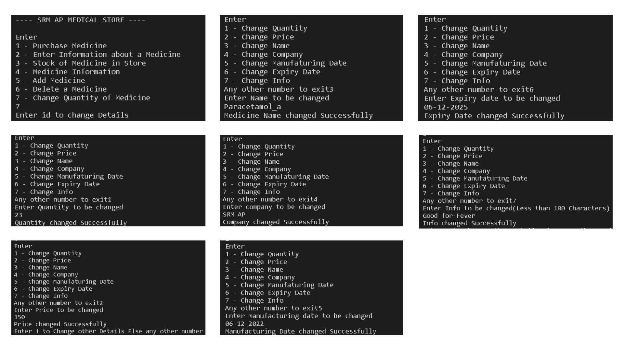
Output

Slide 15
Conclusion
The SRM Medical Store Management System automates medical store operations, ensuring efficiency, accuracy, and ease of use. It addresses key challenges like stock management, billing errors, and time-consuming processes.
Key Benefits:
Reduces human errors.
Provides real-time stock updates.
Enhances customer satisfaction with faster billing and better service.
The system is scalable and adaptable for future improvements, such as AI-based demand forecasting and mobile app integration.Overall, the project demonstrates the power of automation in simplifying operations and saving time for medical store professionals.

Slide 16
Thank You
Any Questions

